Slide 1
Retrieval of Relevant Answers to StackOverflow Queries by Ranking the Answers
Akhil Kumar Baipaneni
Gayathri Chandrasekaran
Madhuri Yadav

Slide 2

Question and Answer site for enthusiast Programmers
Platform for users to ask and answer question
Solutions to Majority of problems faced by beginners and the professionals
Shortcomings:
If you have a problem you can't solve alone, we seek for the answer on stack overflow. Is solution you looking for is available easily on links?
Search results are not up to the expectation
Some solutions irrelevant to the questions
It has flaws in the information retrieval process.

Slide 3

Proposed Solution
Search Algorithm :
Information Retrieval - NLP techniques - Text Similarity
How it works - User search - Question - Similar questions are retrieved along with Answers
Most of the researches were focused on clustering identical questions & improving text similarity models for retrieval. Question and Answer relevance testing is overlooked.
Aim: To study semantic similarity between question and answer choices available in Q&A system and produce most relevant answers to the question searched.

Slide 4
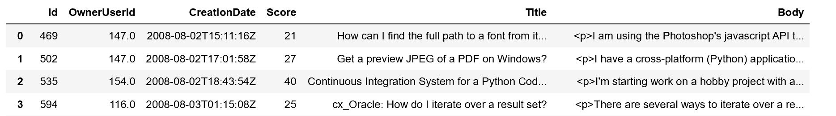
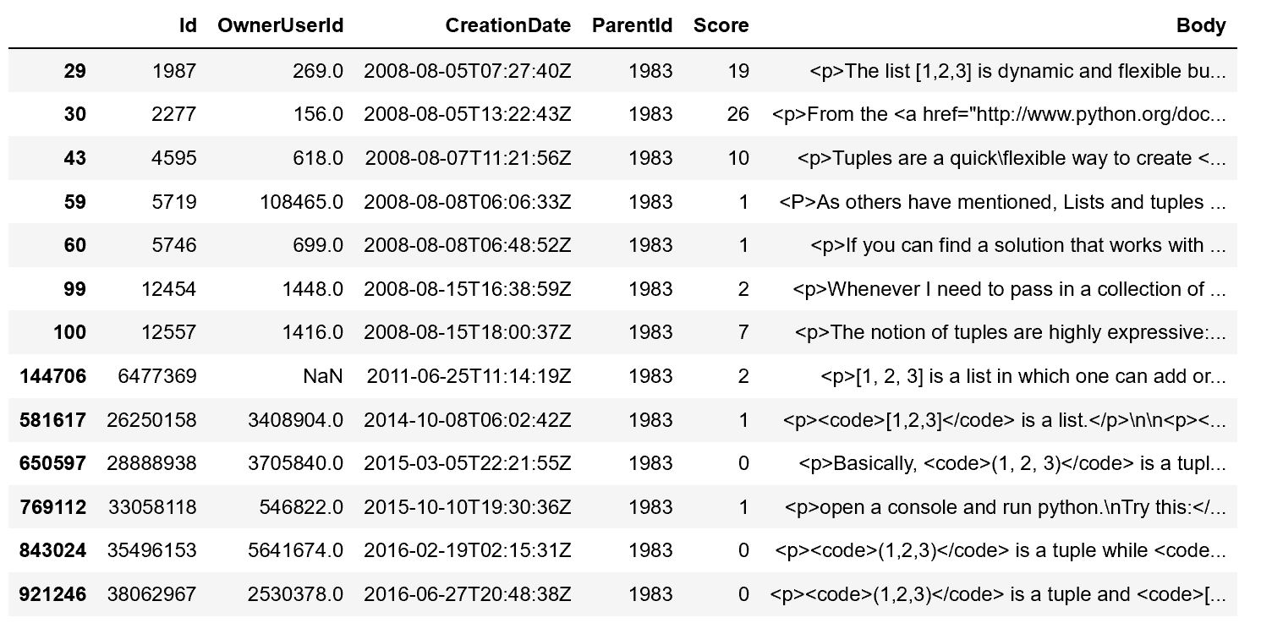
Dataset
Data - Kaggle - Python Questions from StackOverflow (https://www.kaggle.com/stackoverflow/pythonquestions)
Range - August 2, 2008 to October 19,2016.
Data Source : Google BigQuery - Complete Stackoverflow data is loaded in google cloud - Link
Questions - 607,282 Observations
Answers - 987,122 Observations
Questions: Answers:
One to Many Relation - each Question can have more than 1 answer

Slide 5
Scope of the Project
Proposed Set up:
Data Collection and Data Preprocessing
Grouping identical questions
Clustering related answers - For each question group, related answers are aggregated and clustered.
Ranking Clustered Answers - Based on relevance with question and answer clusters
Tools:
Python libraries - nltk, spacy
Semantic similarity techniques - Jaccard Similarity, Cosine Similarity, etc.
Grouping/Clustering - CBC(Cluster based on committees), Shingles
Evaluation:
Manual Evaluation - Randomly checking answer set by searching questions

Slide 6
References:
https://stackoverflow.com/company/logos
http://autosandelectro.blogspot.com/2016/10/aim-of-autos-electro-karachiites.html
https://www.aclweb.org/anthology/N18-4017.pdf

Slide 7
Questions?
Thank You

